Slide 1


Research Coordination System
Supervised by:
Ms. Nusrat Jahan
Senior Lecturer, Department of Swe
Submitted by:
Sabbir Ahammed
ID: 171-35-1979

Slide 2
Background of study
The project entitled “Research Development of Software Department” aim is to minimize the extra management work of research papers for the faculty members and coordinators. This web application will automatically manage the paperwork, will record the progress and will notify the users with their tasks deadlines. The Research Development Head will be able to control the Coordinators and faculty members with their work very easily.

Slide 3
Functional requirements
Log In
Update Profile
Register New Faculty
Assign Coordinator
Manage Task
Notification
Submit Research Paper Details
Report Writer
Log Out

Slide 4
Non-Functional requirements
Usability
Recoverability
Security
Availability
Reliability

Slide 5
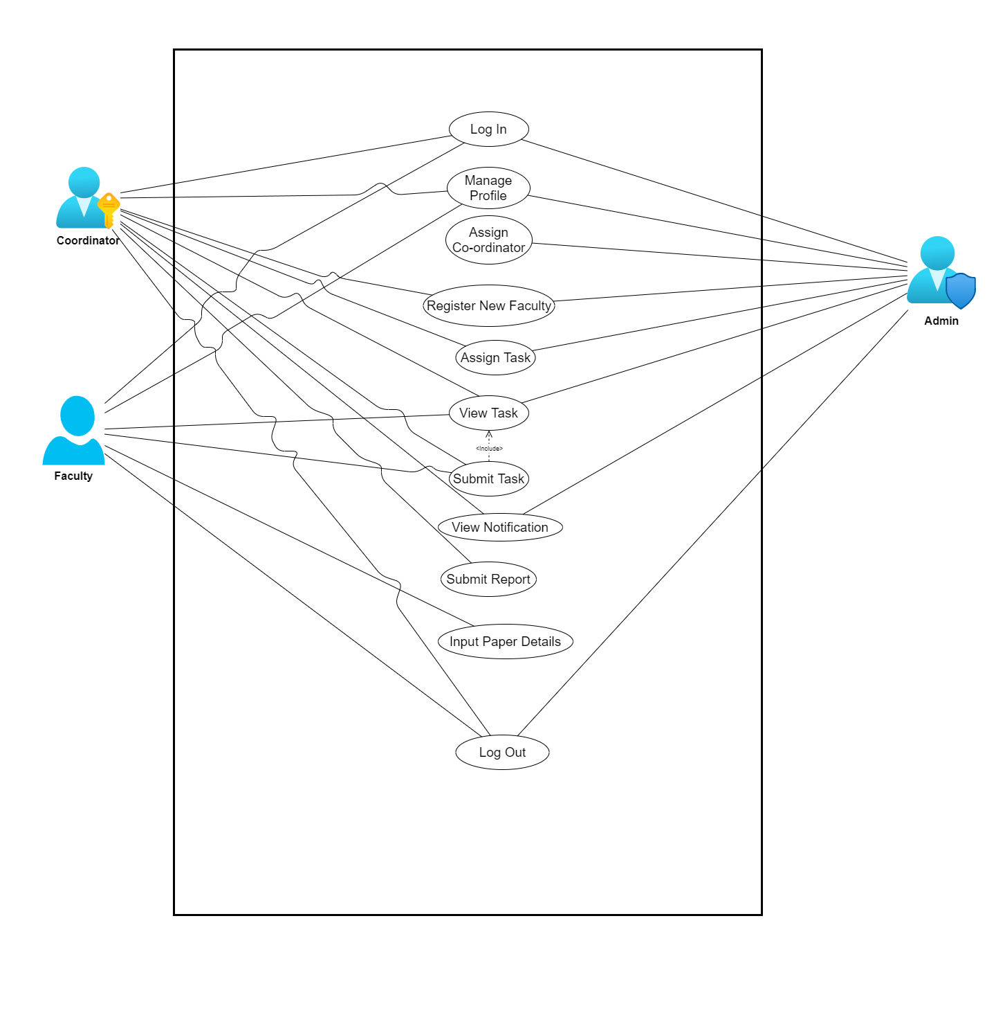
Use case diagram

Slide 6
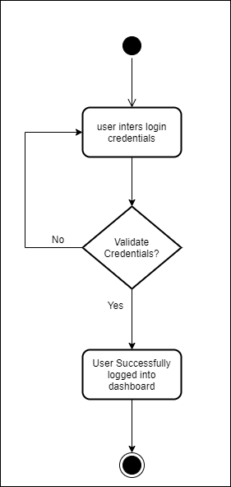
Activity diagram for log in

Slide 7
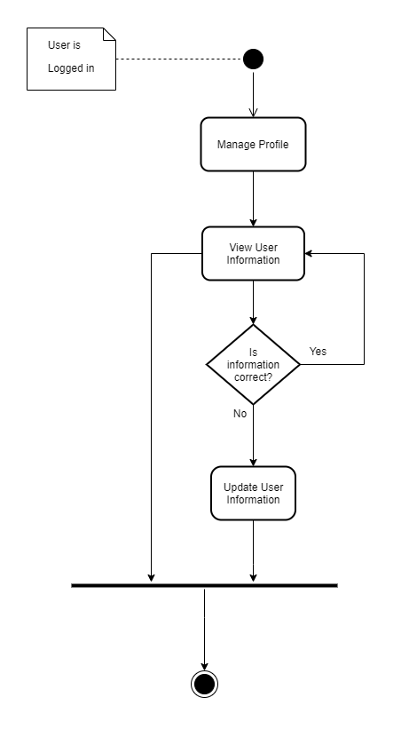
Activity diagram for update profile

Slide 8
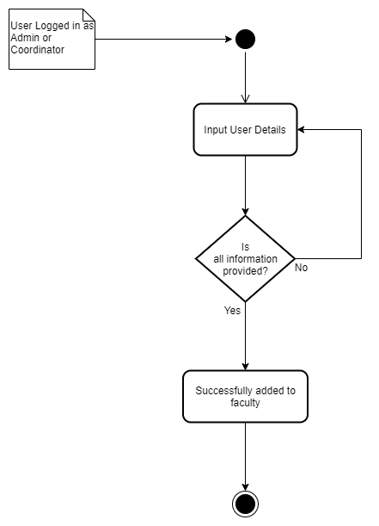
Activity diagram for assign user

Slide 9
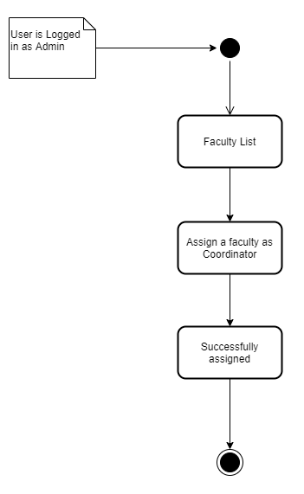
Activity diagram for assign coordinator

Slide 10
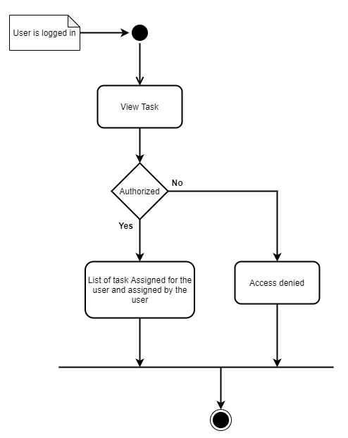
Activity diagram for View tasks

Slide 11
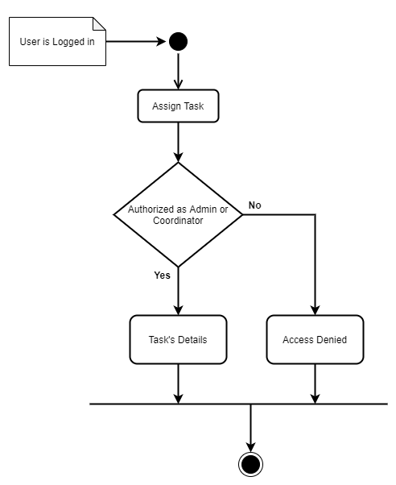
Activity diagram for Assign task

Slide 12
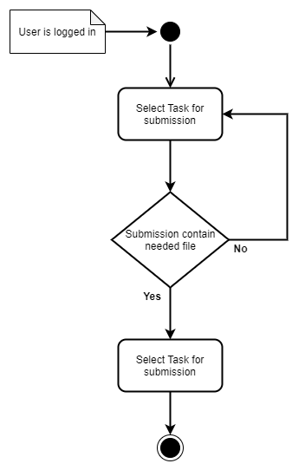
Activity diagram for Submit task

Slide 13
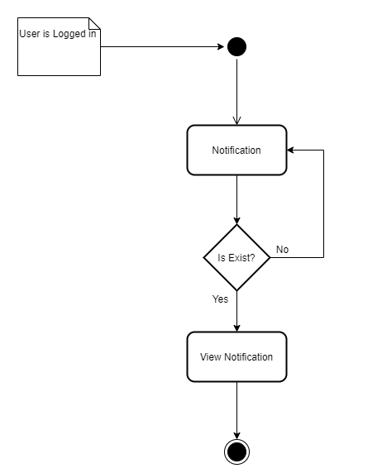
Activity diagram for notification

Slide 14
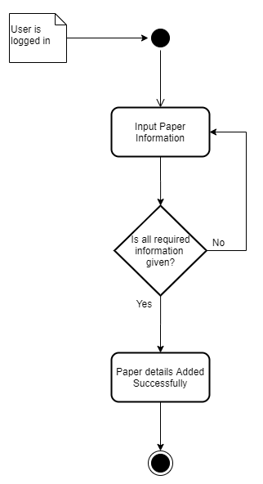
Activity diagram for paper assign

Slide 15
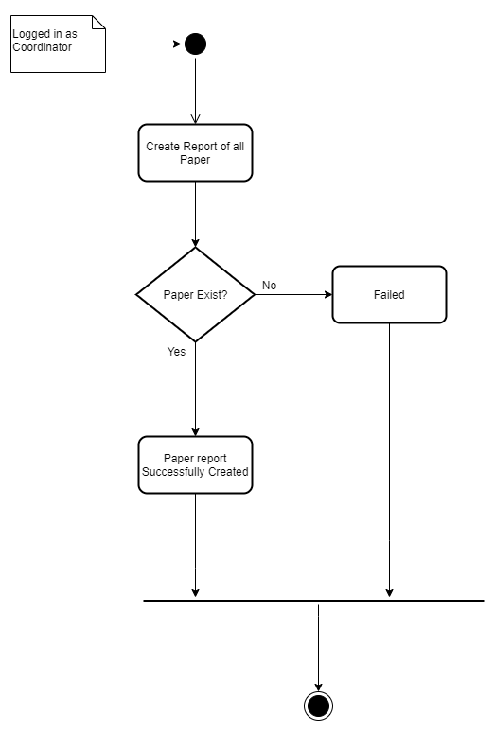
Activity diagram for paper report

Slide 16
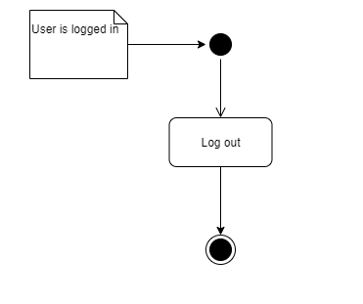
Activity diagram for logout

Slide 17
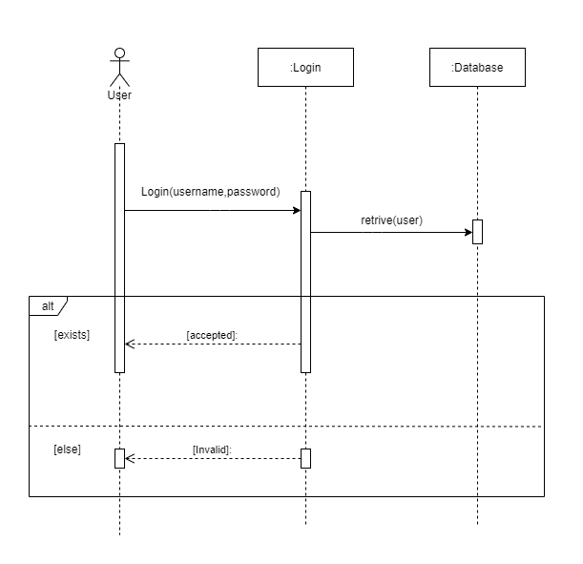
sequence diagram for log in

Slide 18
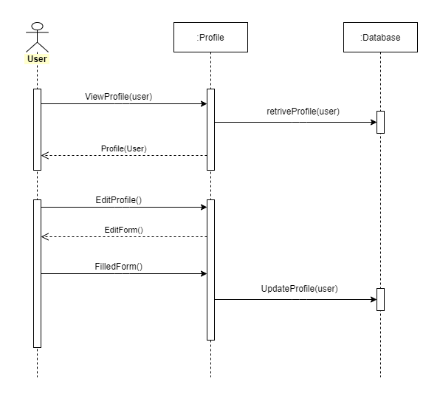
sequence diagram for update profile

Slide 19
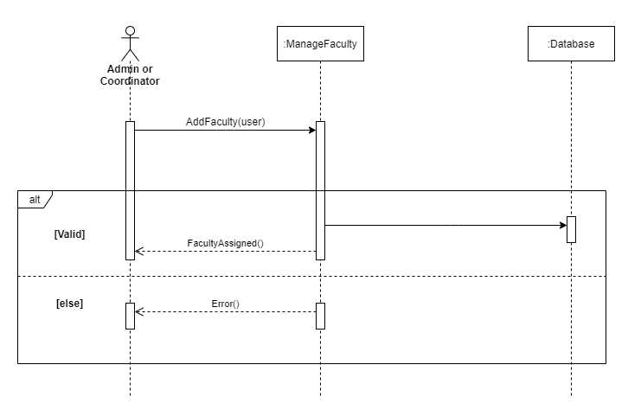
sequence diagram for Register new faculty

Slide 20
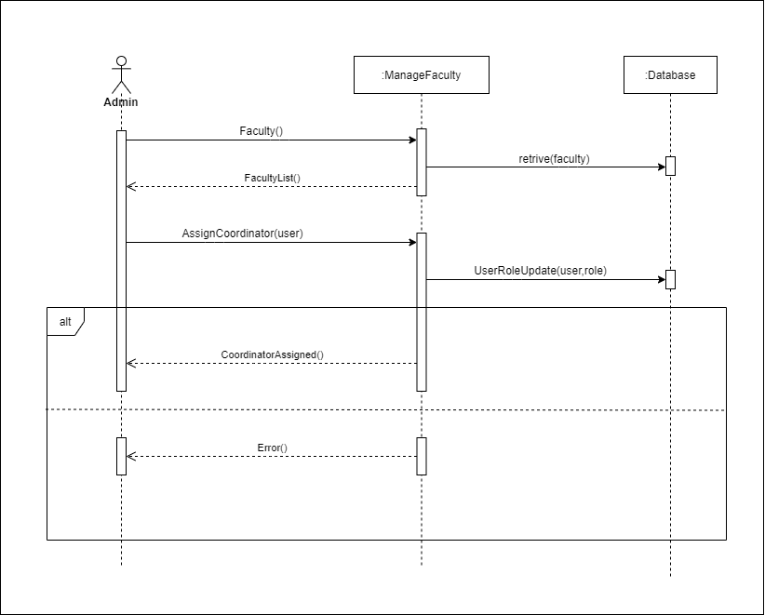
sequence diagram for assign coordinator

Slide 21
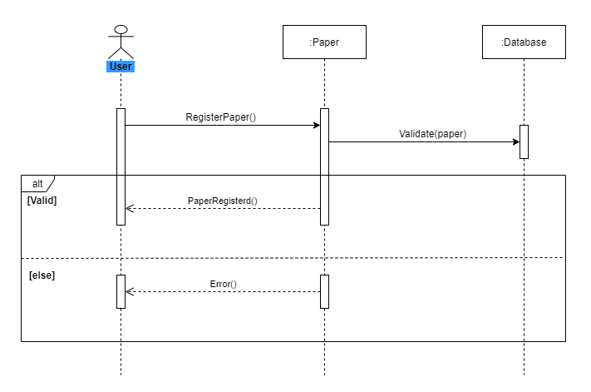
sequence diagram for manage paper

Slide 22
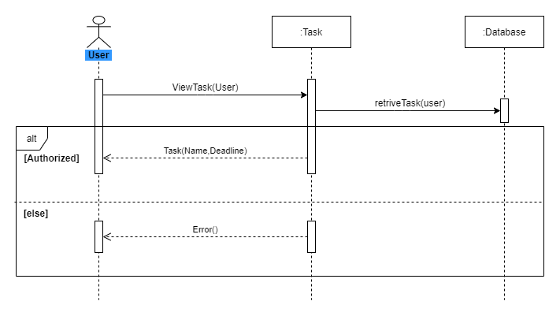
sequence diagram for task view

Slide 23
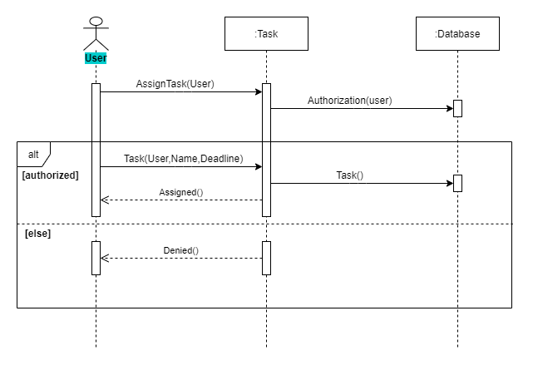
sequence diagram for task assign

Slide 24
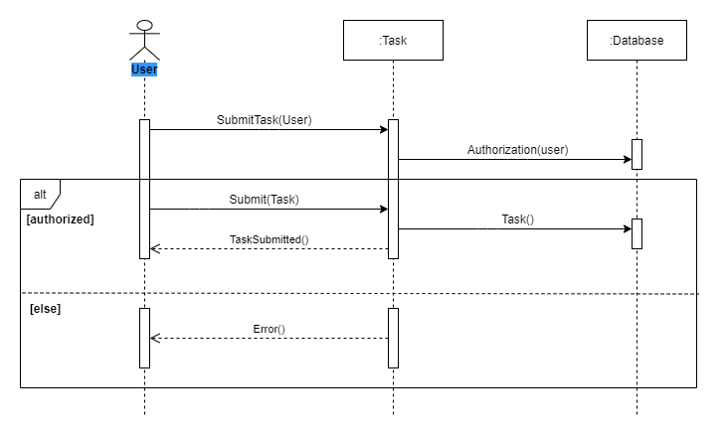
sequence diagram for task submit

Slide 25
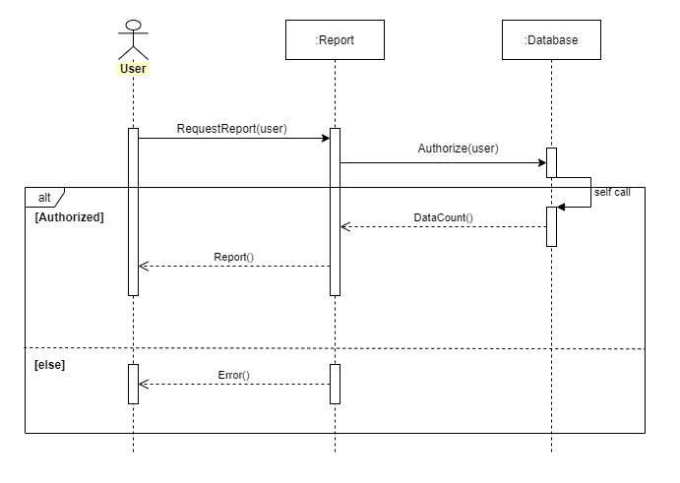
sequence diagram for report writing

Slide 26
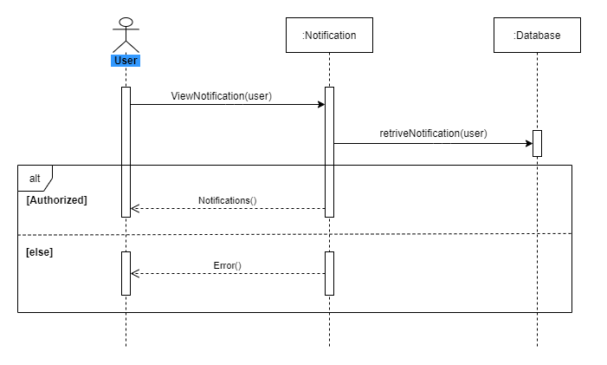
sequence diagram for notification

Slide 27
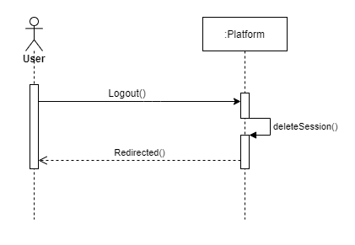
sequence diagram for logout

Slide 28
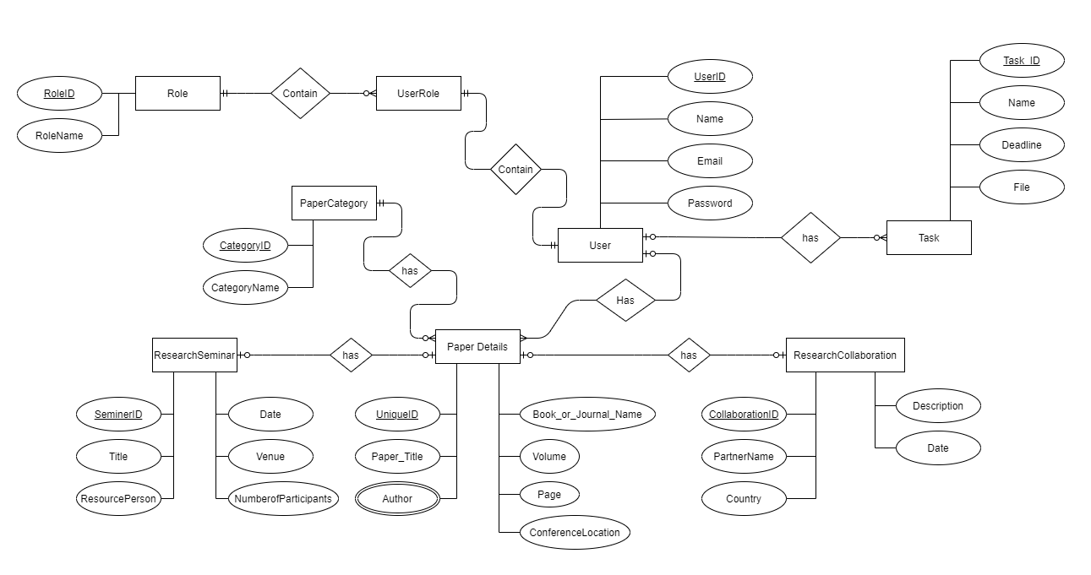
Entity relationship diagram

Slide 29
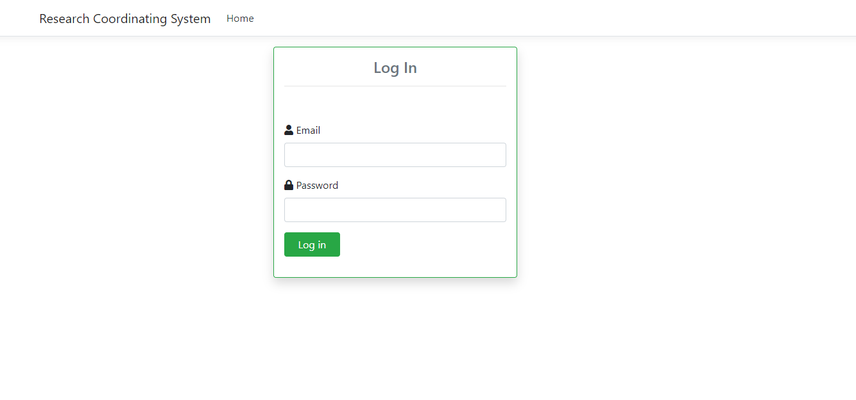
Login

Slide 30
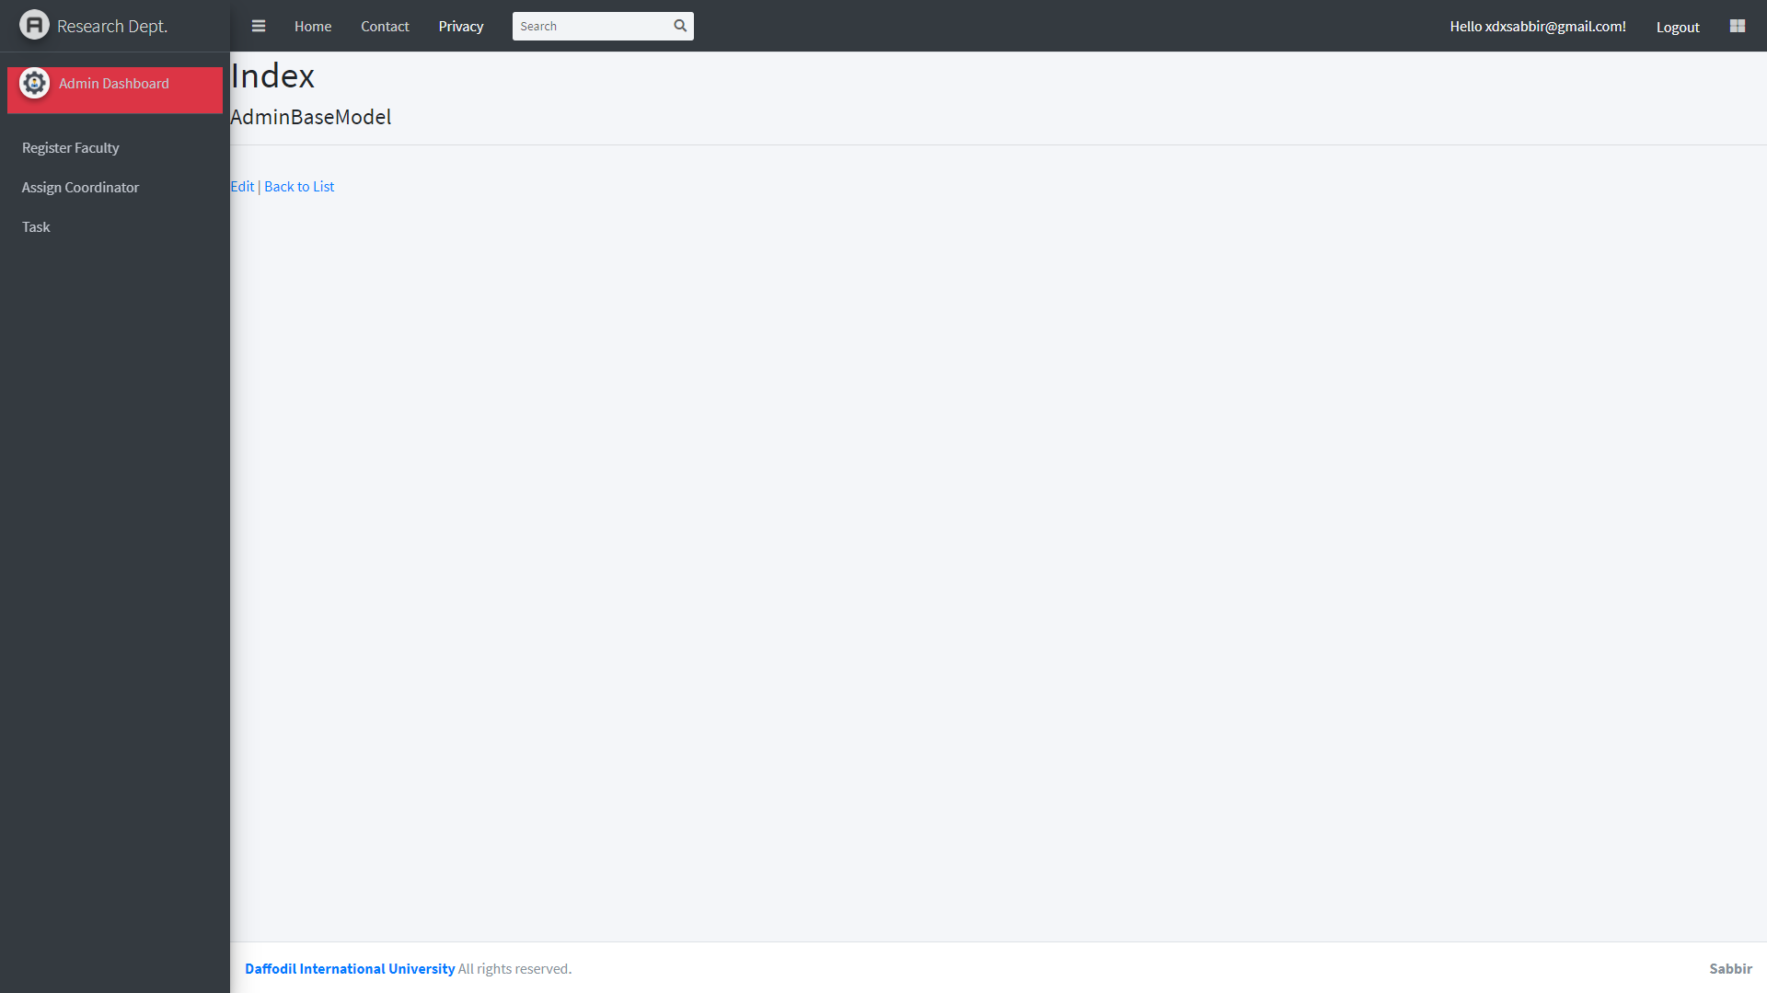
Admin dashboard

Slide 31
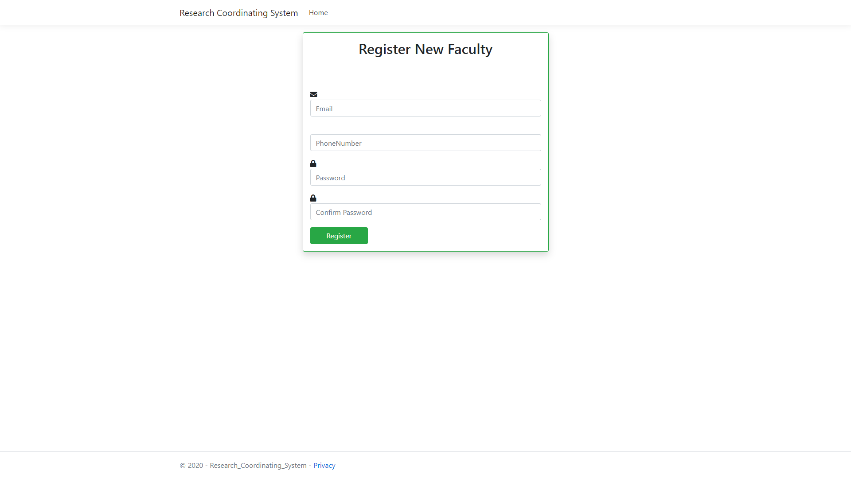
Register new faculty

Slide 32
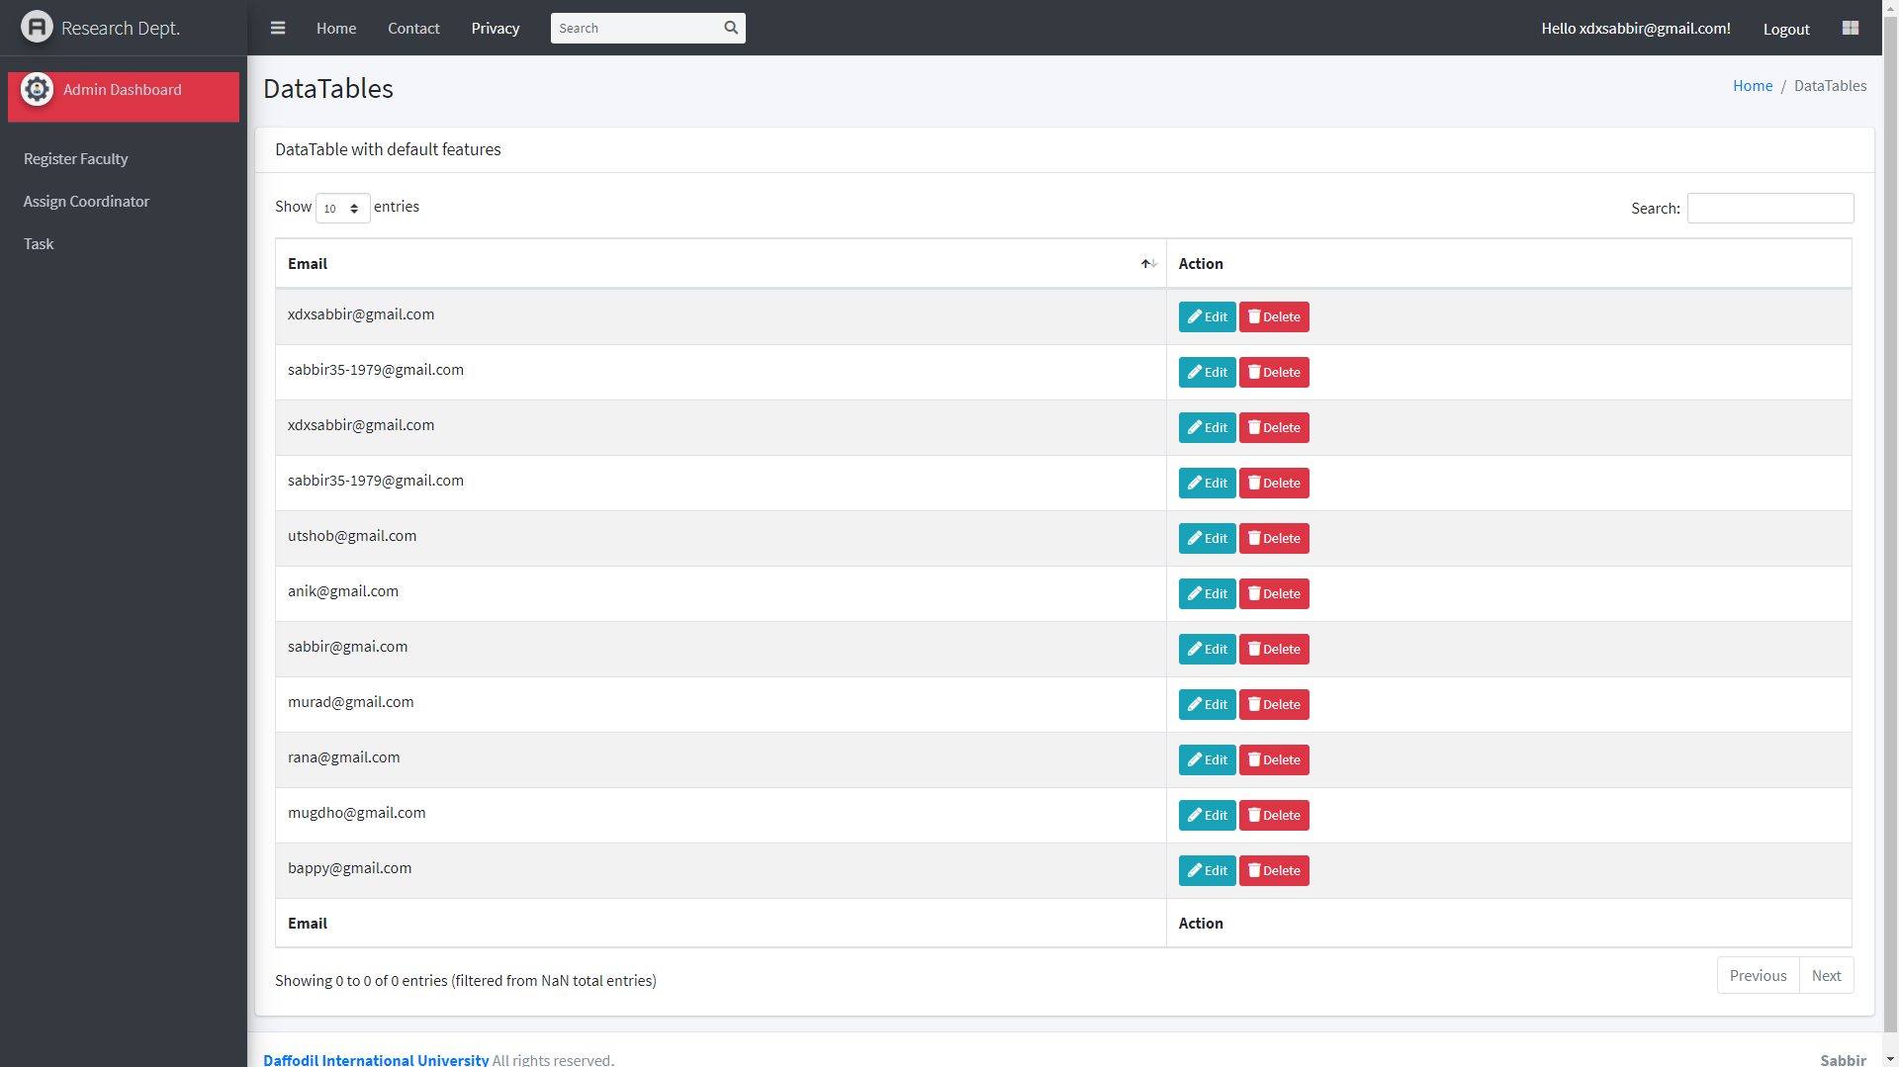
Assigning role

Slide 33
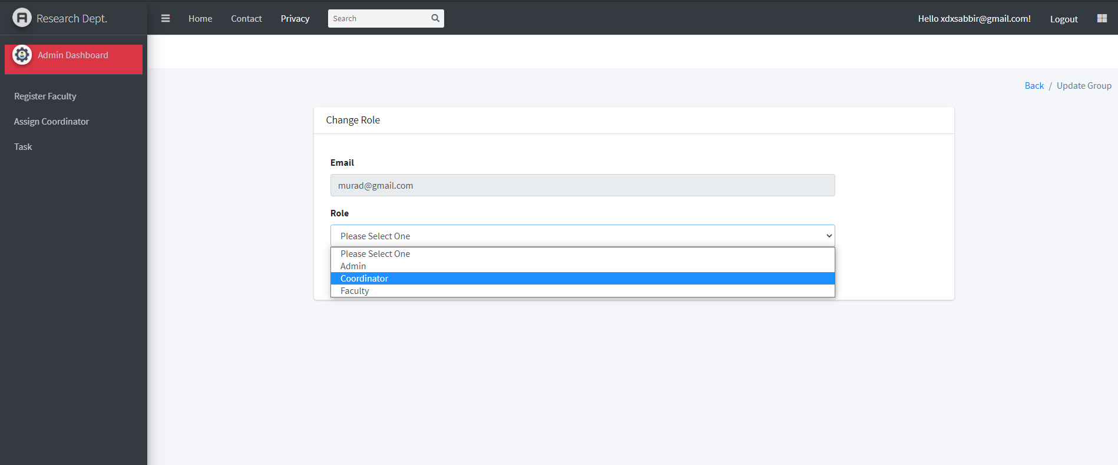
Assigning role

Slide 34
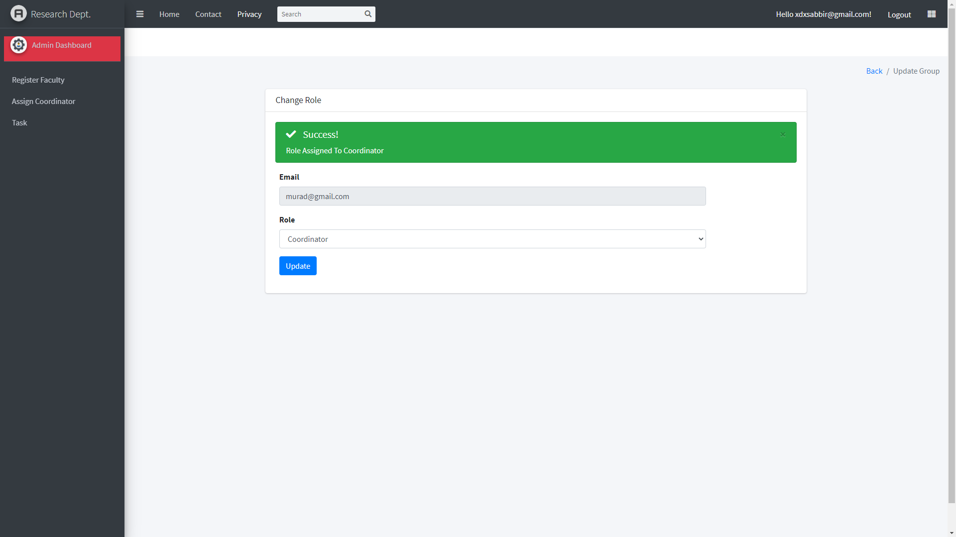
Assigning role

Slide 35
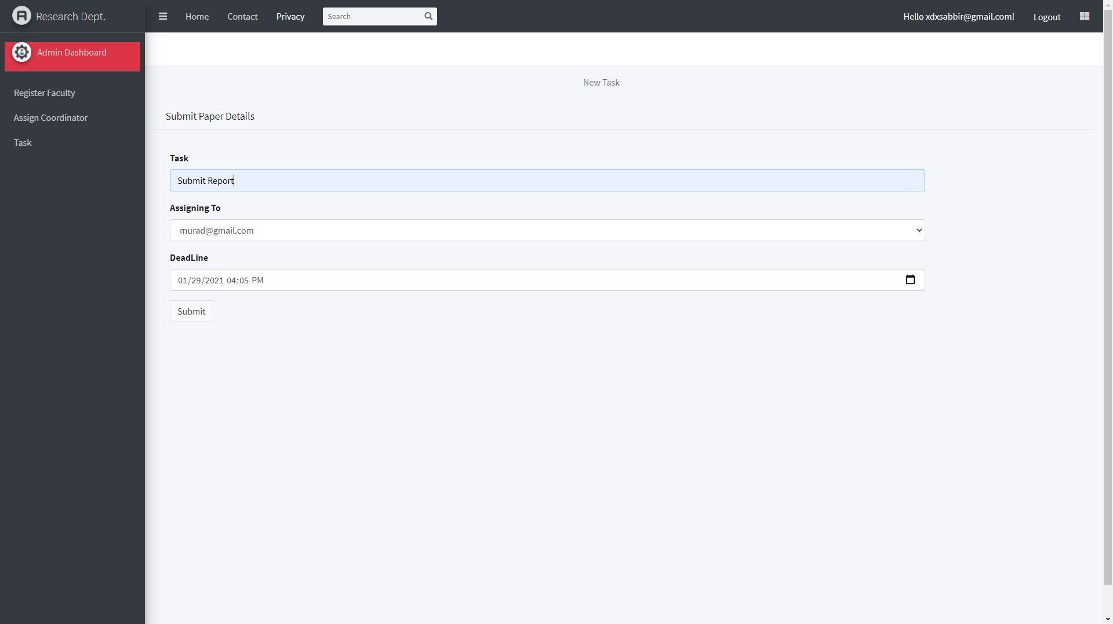
Assigning task

Slide 36
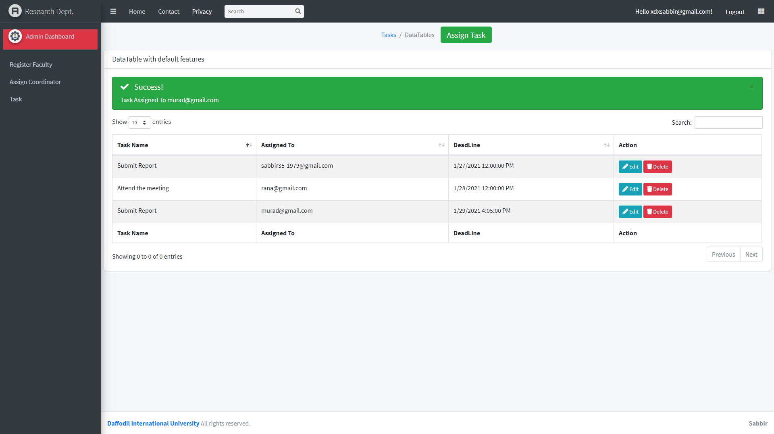
Assigning task

Slide 37
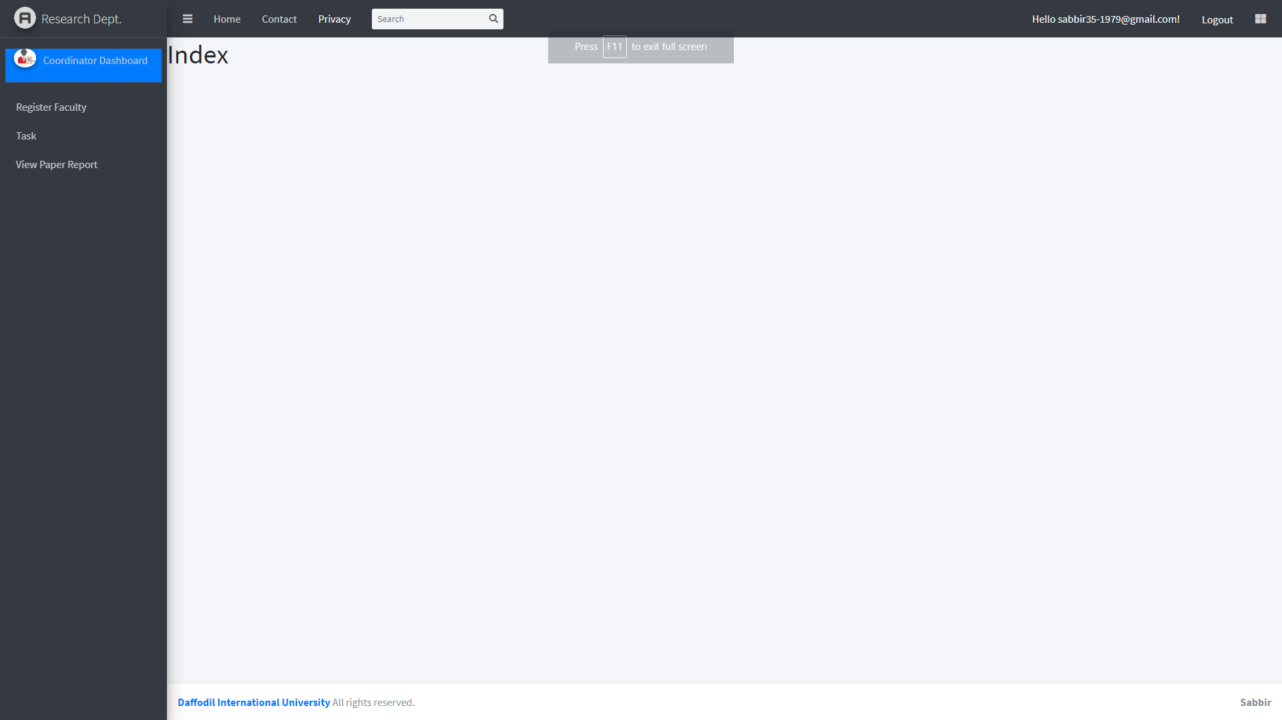
Coordinator dashboard

Slide 38
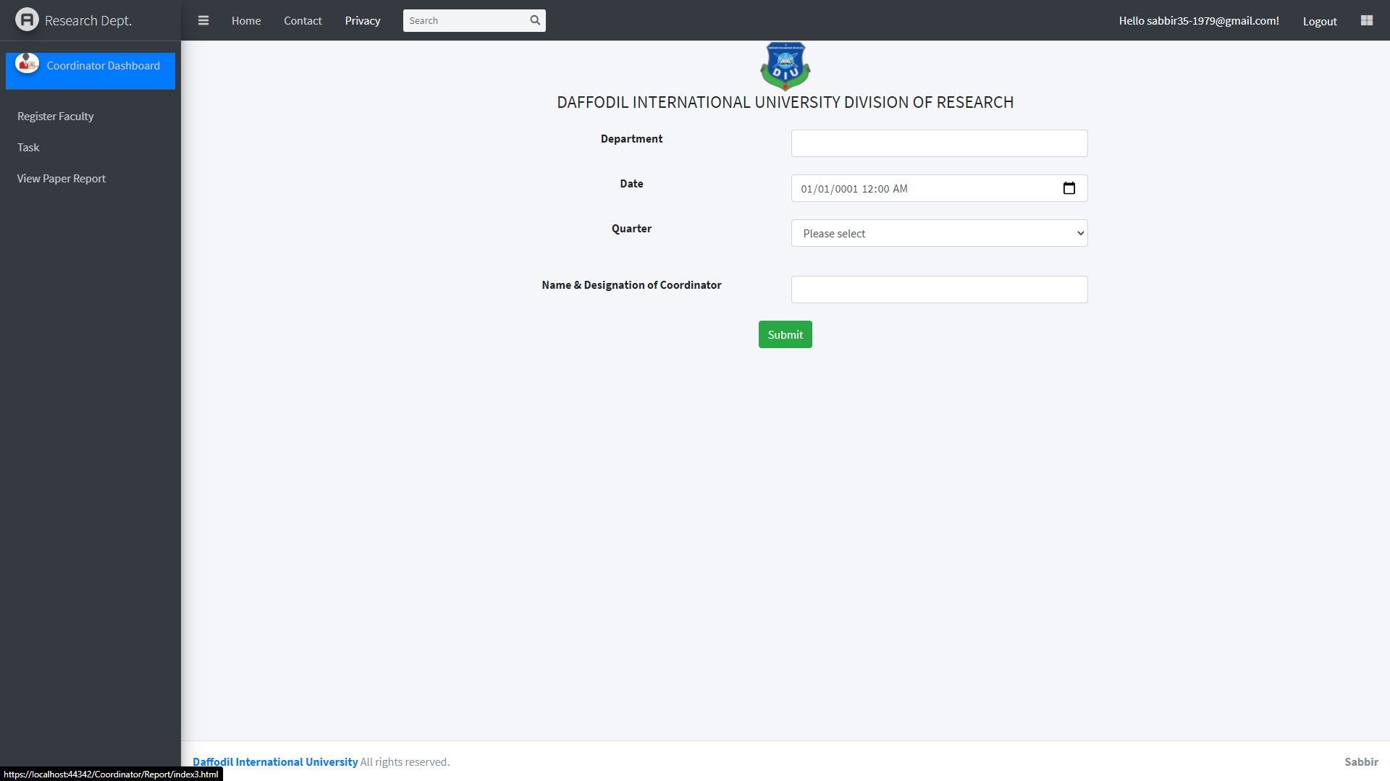
View paper report

Slide 39
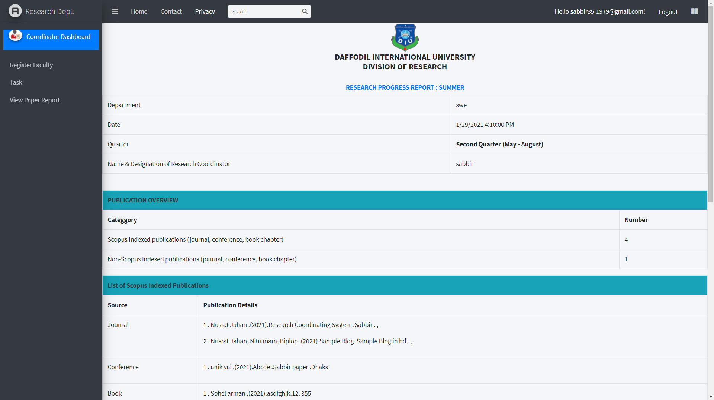
View paper report

Slide 40
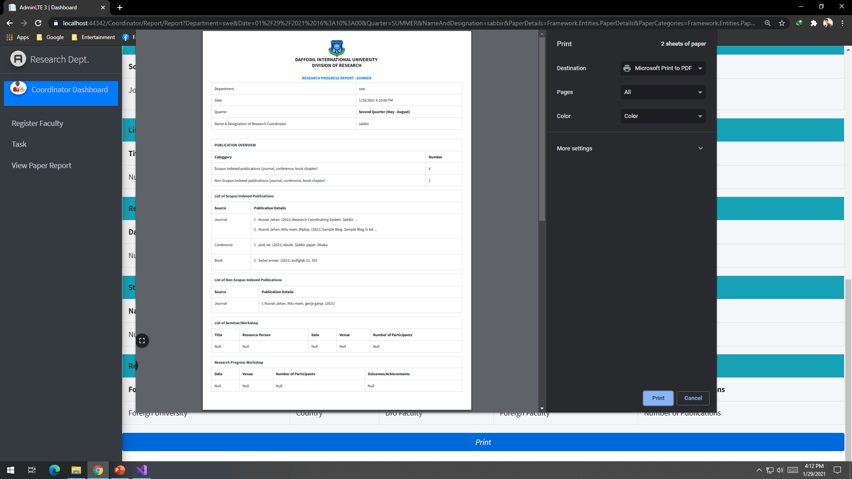
Print paper report

Slide 41
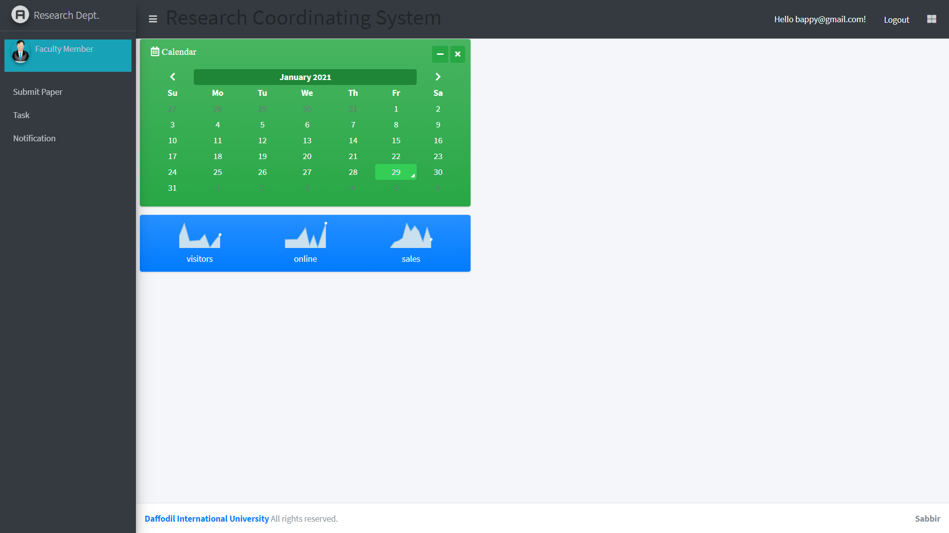
Faculty dashboard

Slide 42
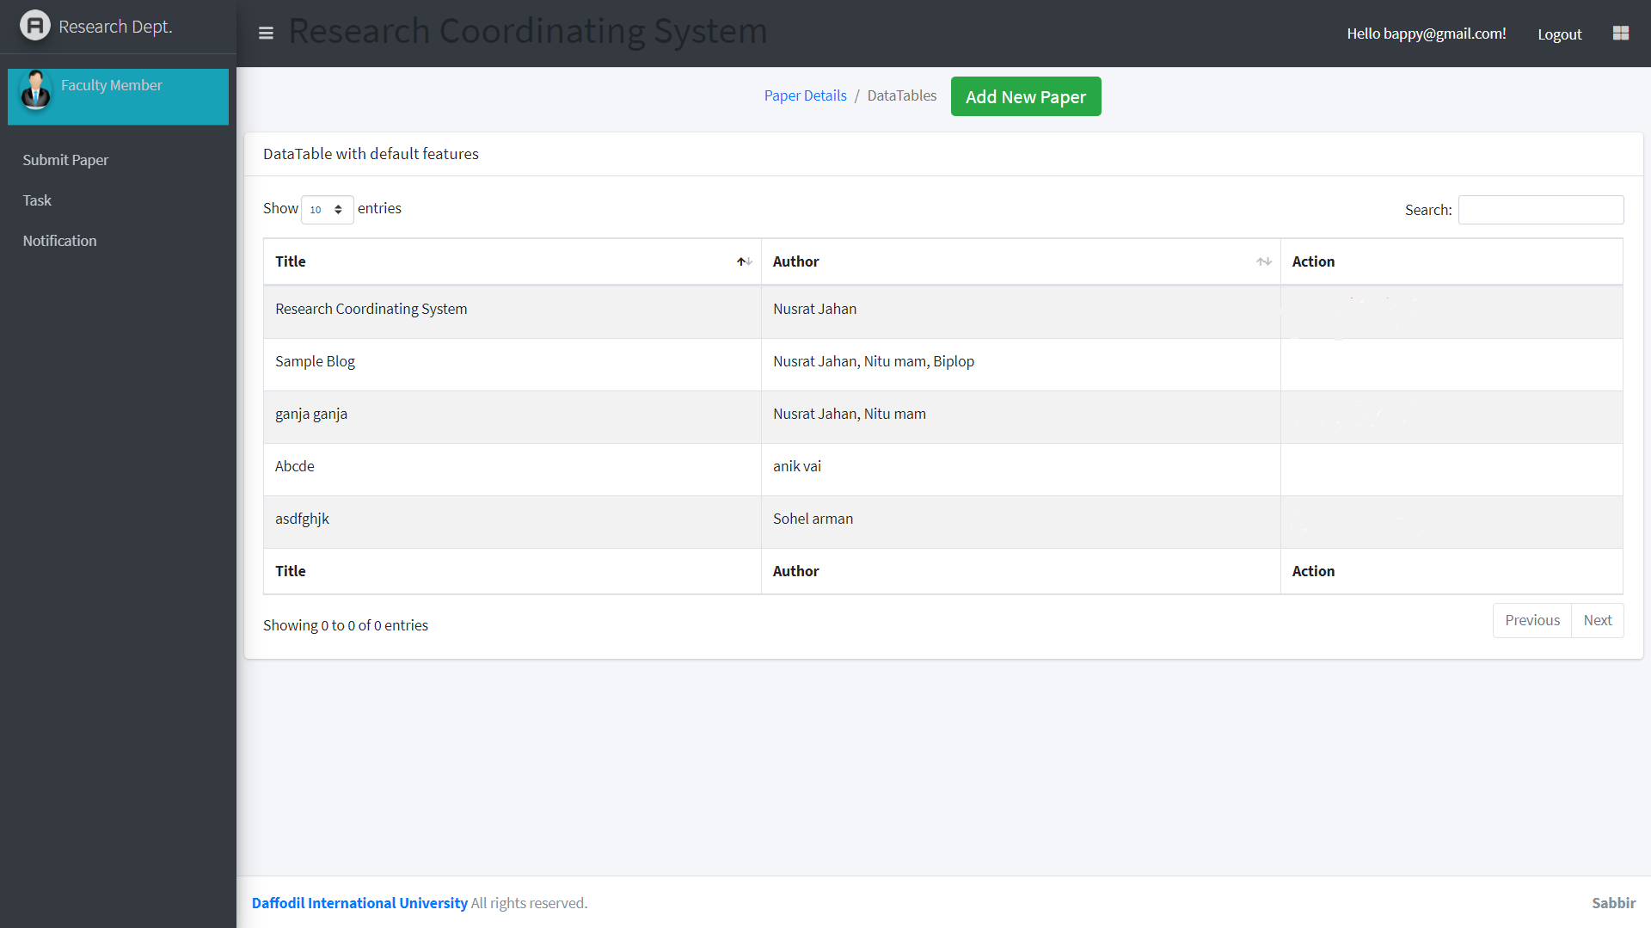
Submit paper details

Slide 43
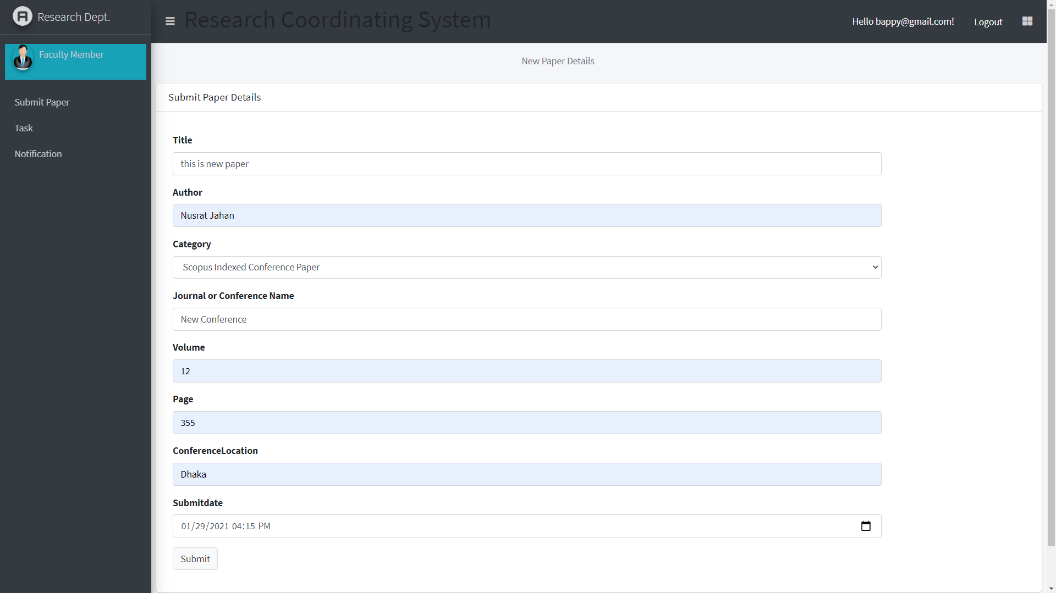
Submit paper details

Slide 44
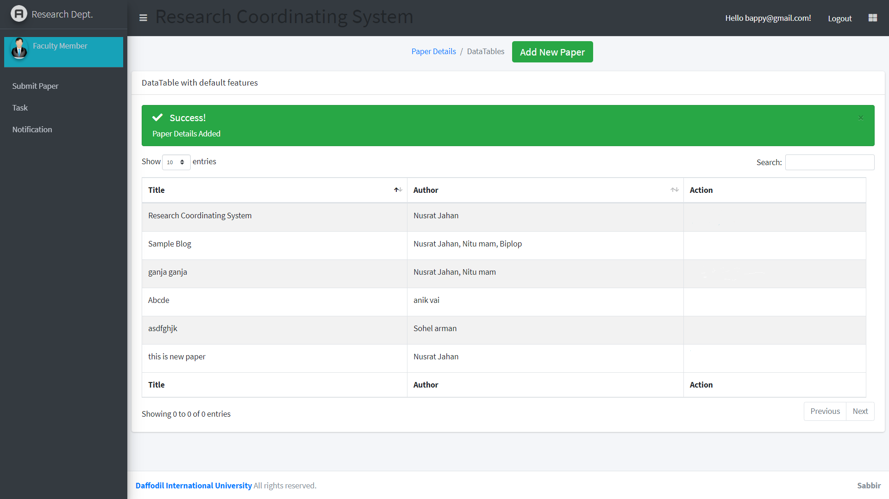
Submit paper details

Slide 45
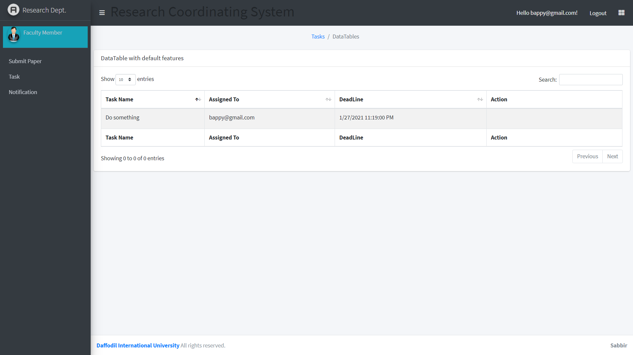
Tasks

Slide 46
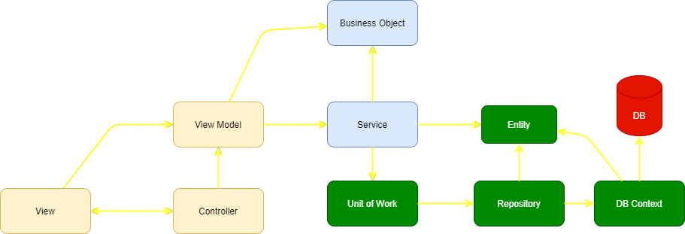
Architecture used

Slide 47
TECHNOLOGY USED
Windows : 10
Language : C#
Framework: Dot net Framework , Entity Framework Core, Identity, MVC
Data base : MSSQL server
Platform : Visual Studio

Slide 48
GitHub link
https://github.com/I-am-Sabbir/Research_Coordinating_System

Slide 49
Thank You;

